Slide 1
NOSTALGIC GAME HUBB
Done By: PLUGIN IMMORTALS
Keerthana Devi S K
Kishore M
Kishore V
Padmanaban B
Prajeesh S
Sabari K G
Saisukirtha S

Slide 2
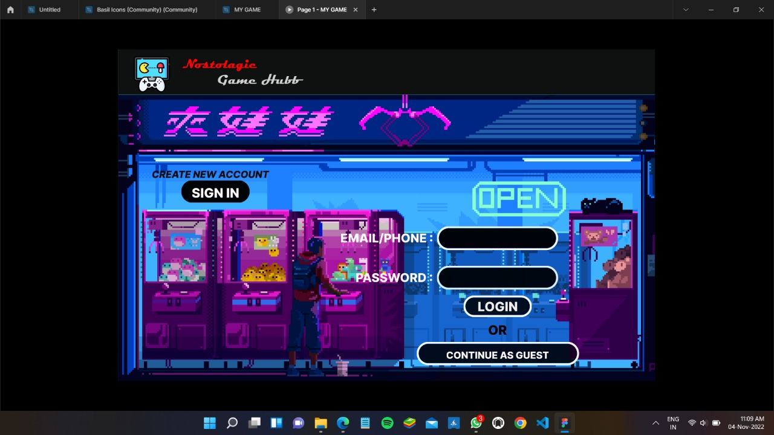

Slide 3
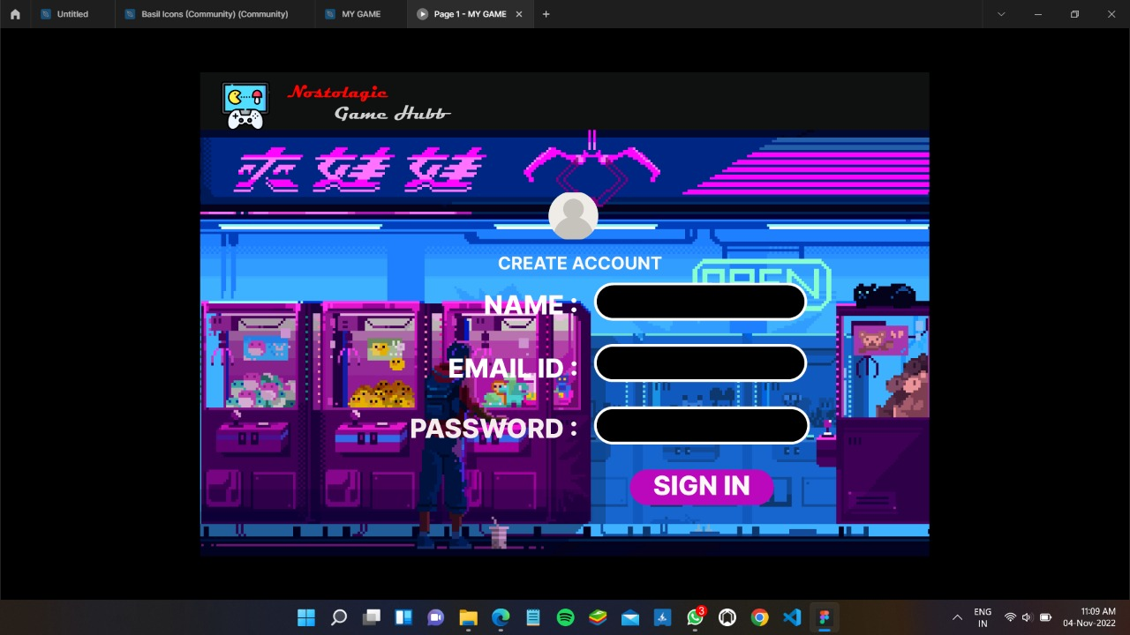

Slide 4
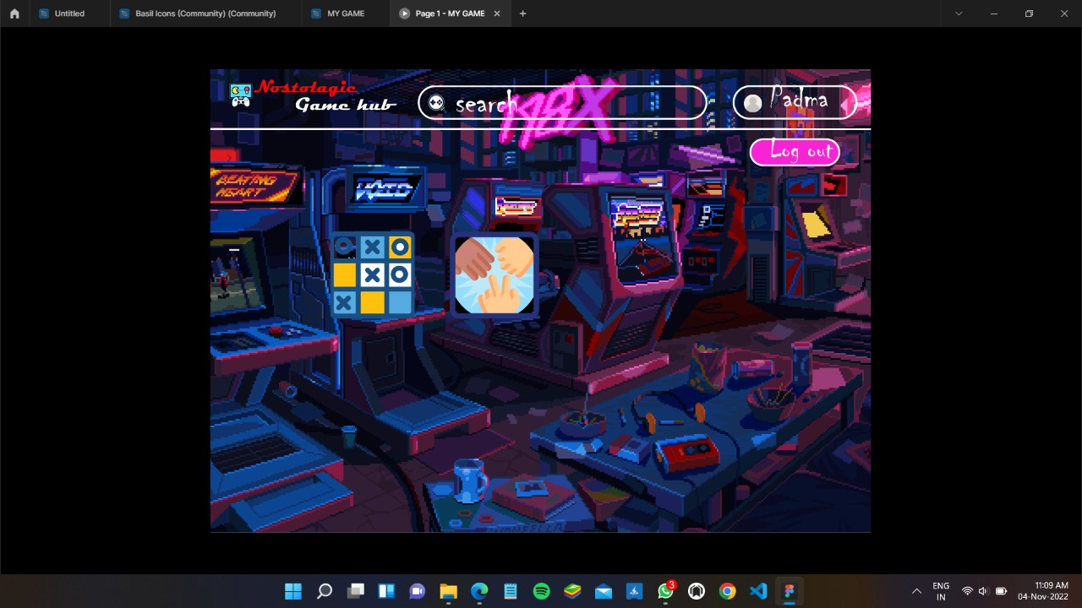

Slide 5
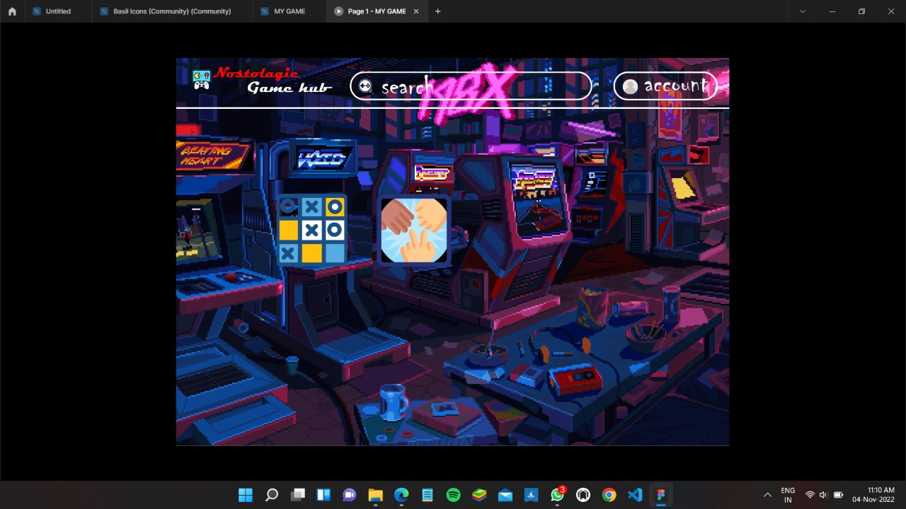

Slide 6
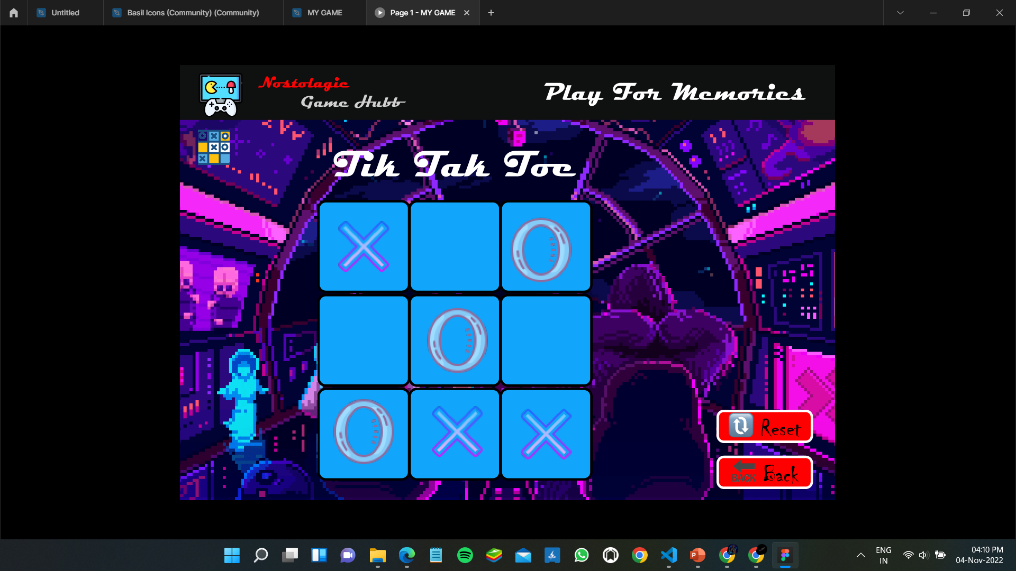

Slide 7
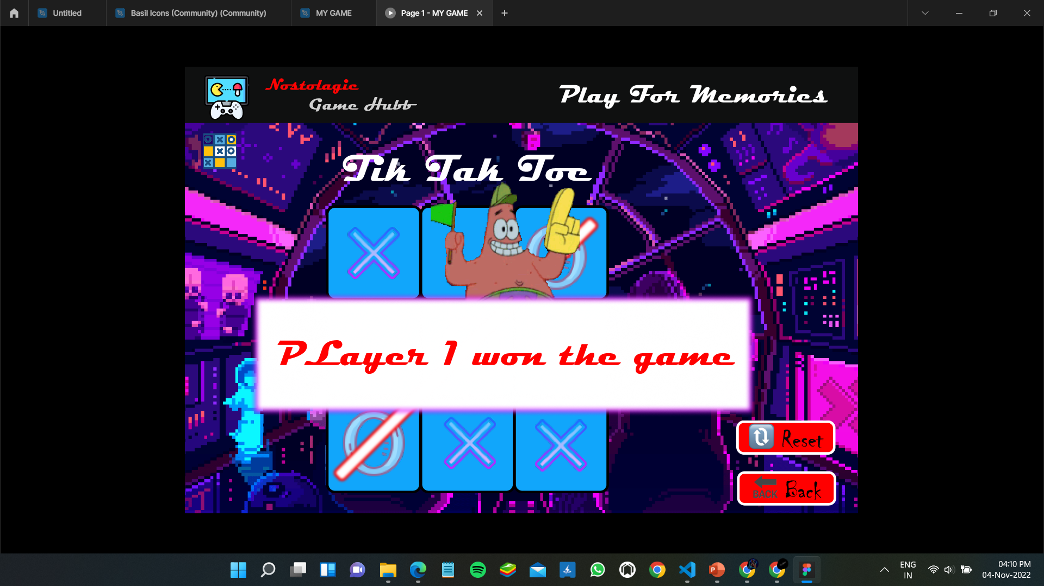

Slide 8
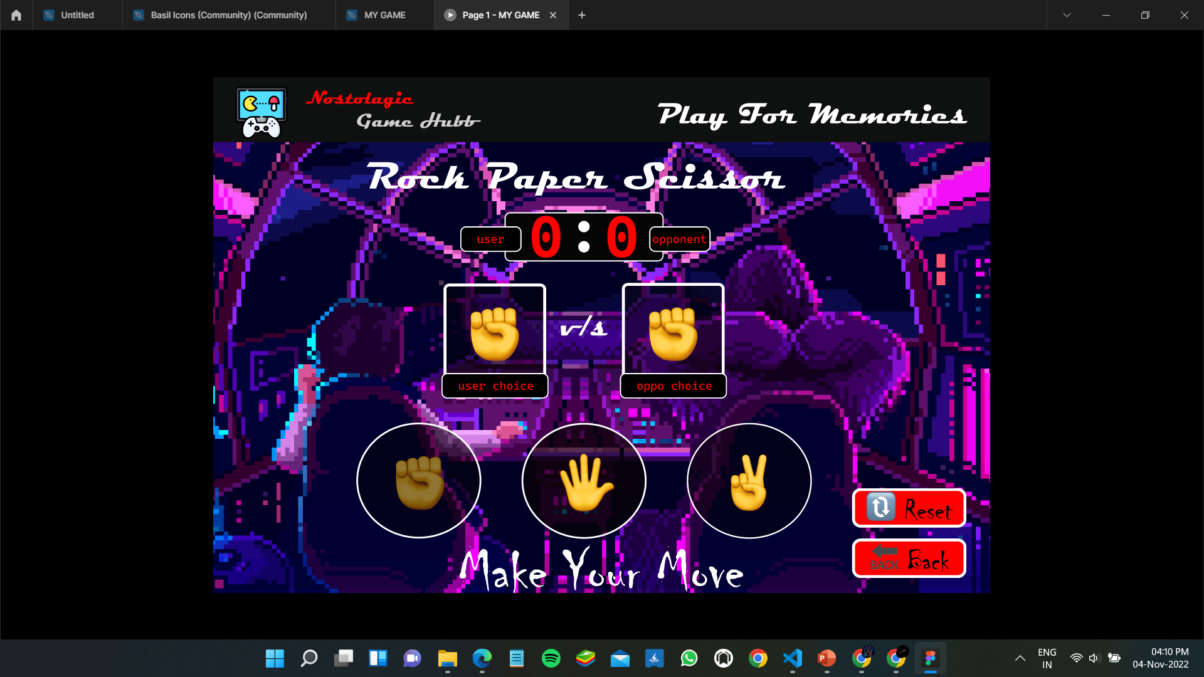

Slide 9
Figma link: https://www.figma.com/file/DnwyHpLl0XJegezykj90Dn/MY-GAME?node-id=0%3A1

